Slide 1
the niche and species’ geographic distributions
A. Michelle Lawing, PhD
Associate Professor
Paleoecology, Evolution, and Climate Lab
Ecology and Conservation Biology
Texas A&M University
alawing@tamu.edu
Figure 2.1. Distribution of the California Thrasher (Toxostoma redivivum) in California, from Grinnell (1917). Approximate distributional limits of the three subspecies are shown with different shadings, and occurrences are shown as dots (for specimens) or triangles (for published records).
Peterson, A.T., Soberón, J., Pearson, R.G., Anderson, R.P., Martínez-Meyer, E., Nakamura, M. and Araújo, M.B., 2011. Ecological niches and geographic distributions (Vol. 49). Princeton University Press.

Slide 3
Welcome and Introductions

Slide 4
On paper or on your computer please write…
Your Name
Degree Program, Department
What do you study?
What is your previous R/coding experience?
Why are you taking this class?
What is your prior experience with niches and species distributions?

Slide 5
Round Robin Introductions
Hand in to me or email me your responses at alawing@tamu.edu after introductions

Slide 6
18th – 20th Century People and Concepts

Slide 7
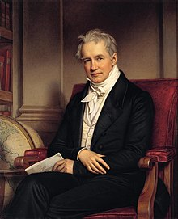
Alexander von Humboldt
1769–1859
Popularized science with his writings
Botanical geography laid foundation for the field of biogeography
Synthesized knowledge from many different fields to form a vision of nature as one interconnected system
The invention of nature – historical account by Andrea Wulf

Slide 8
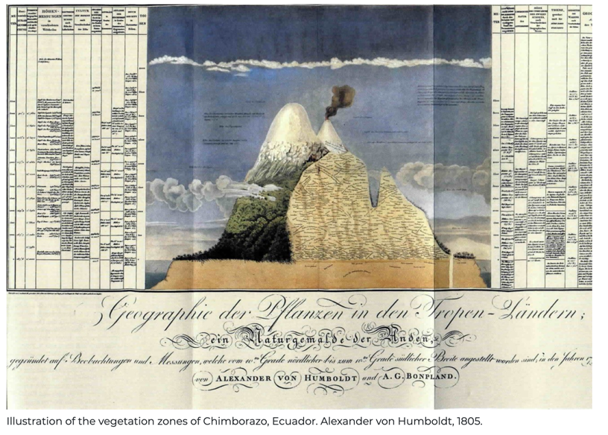
Alexander von Humboldt

Slide 9
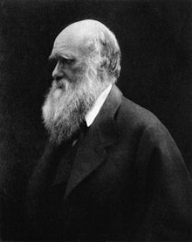
Charles Darwin
1809–1882
On the Origin of Species (1859)
Species are mutable
Theory of evolution by natural selection
Influenced by Humboldt’s Personal Narrative while on the Voyage of the Beagle
His job was the ships naturalist, to collect flora and fauna
He learned taxidermy while studying medicine at the University of Edinburgh

Slide 10

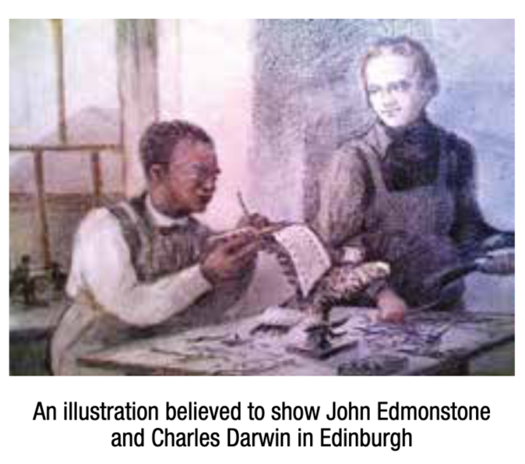
John Edmonstone, a former slave from British Guiana, was instrumental in teaching Darwin the skills of taxidermy and South American flora and fauna. – Sara Middleton

Slide 11
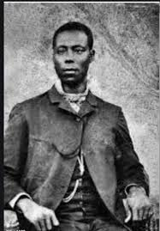
John Edmonstone
Late 1700s – after 1841
Born enslaved in British Guiana, South America
After he was freed, he moved to Glasgow and then Edinburgh
He taught taxidermy at the University of Edinburgh to many students, including Darwin
He inspired Darwin and others with tales of South American flora and fauna

Slide 12
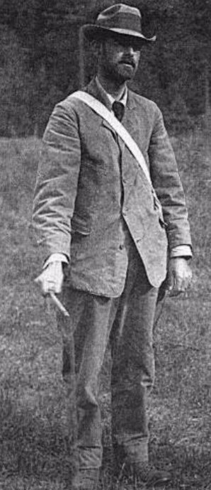
Joseph Grinnell
1877–1939
First director of the Museum of Vertebrate Zoology Berkeley
First use of niche in published paper
Grinnell, J. 1917. The niche relationships of the California Thrasher. The Auk 34: 427-433.
Niche as climate and habitat requirements

Slide 13
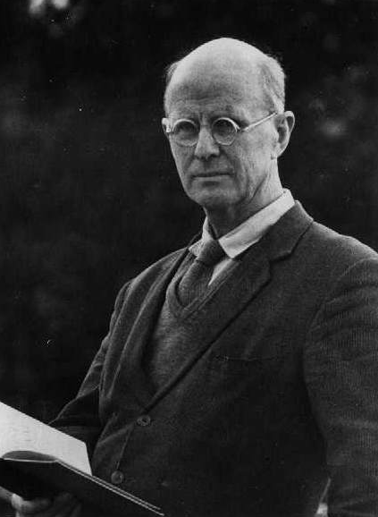
Charles Elton
1900–1991
English Zoologist
Elton, C. 1927. Animal Ecology. Great Britain: William Clowes and Sons Ltd.
Defined the niche a bit differently – the role a species plays
Niche as an occupation-functional role of animal on community

Slide 14
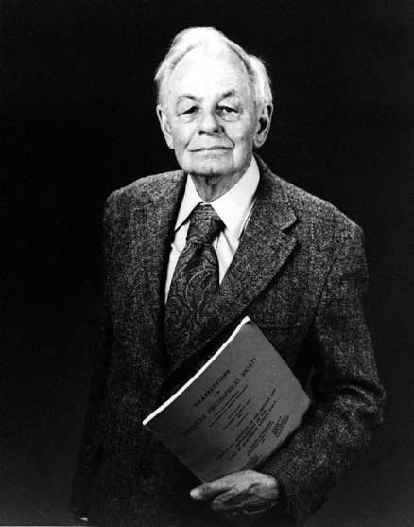
Evelyn Hutchinson
1903–1991
Father of modern ecology
Niche as an n-dimensional hypervolume
Dimensions are environmental conditions and resources that allow a species to exist indefinitely
Defined the concept of fundamental vs. realized niche
Defined the concept of the duality of geographic and environmental spaces
Hutchinson, G.E. 1957. Concluding Remarks. Cold Spring Harbor Symposia on Quantitative Biology 22: 415-427.

Slide 15
The great debates
What is a niche?
How to quantify and compare the niche?
How does a niche relate to geography?
Are various terms the same?
ecological niche modeling
species distribution modeling
habitat suitability modeling
habitat modeling
environmental niche modeling
climate niche modeling
climate envelope modeling

Slide 16
What determines where a species occurs?

Slide 17
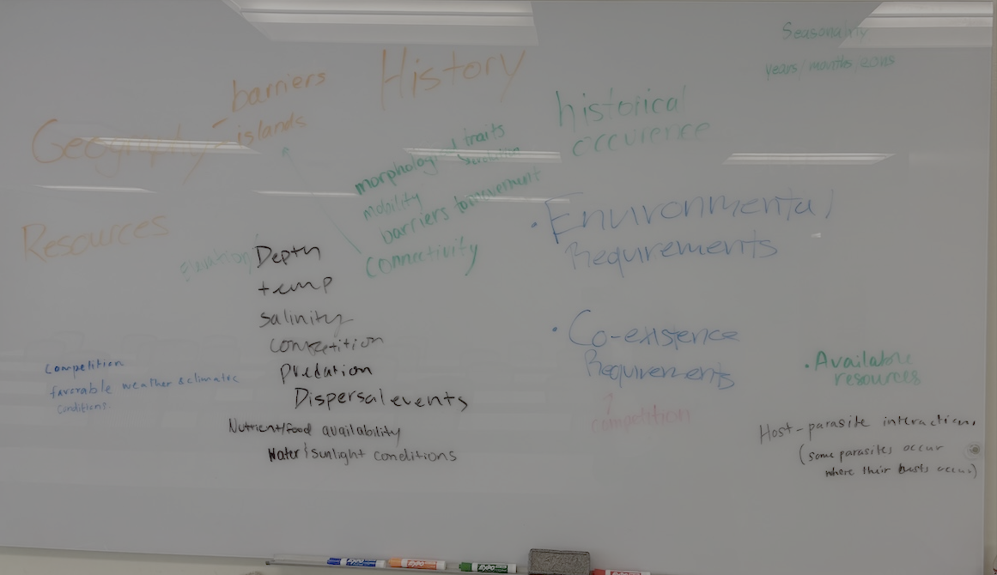

Slide 18
Notes on a scale
Components of a scale
Grain – resolution of the study
Extent – scope of the study
Ecological scale and map scale are exactly opposite
Ecological scale is the size or extent of the landscape under consideration
Map scale is the ratio of the map to the real distance

Slide 19
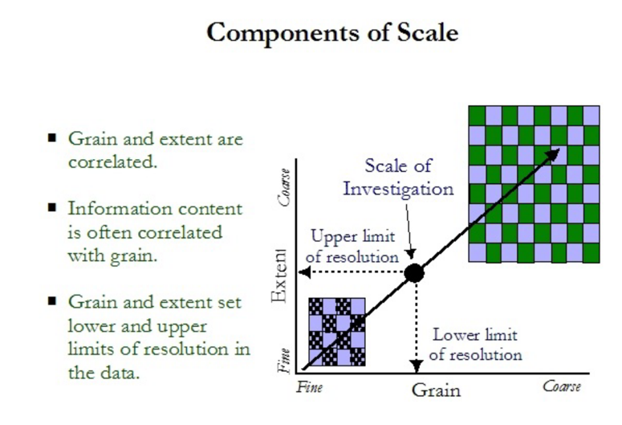
A comment on scales
K. McGarigal. Lecture on Concepts of Scale

Slide 20
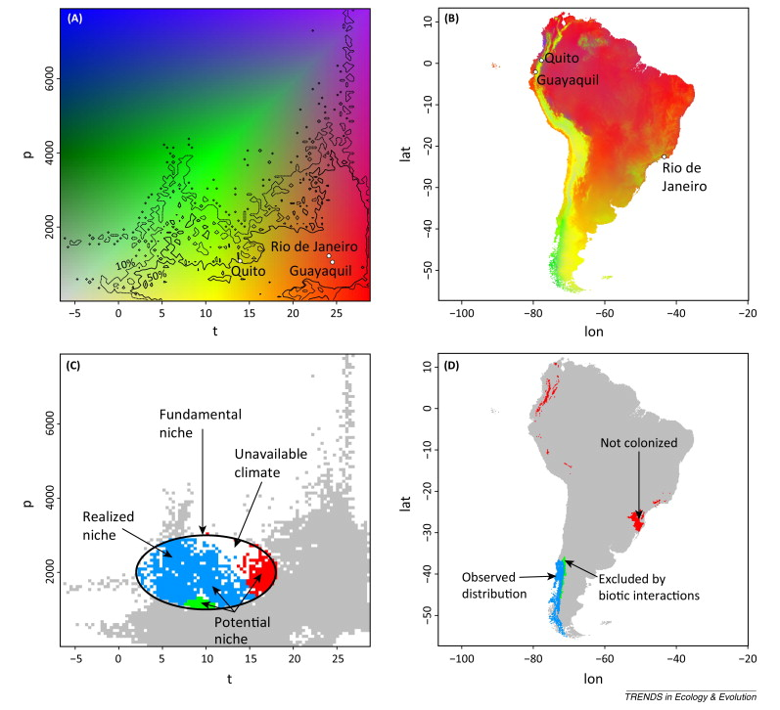
Duality of Geographic and Environmental Spaces
Guisan et al. 2014 TREE

Slide 21
Duality of Geographic and Environmental Spaces
Guisan et al. 2014 TREE

Slide 22
Books for this class
Required
Peterson, A.T., Soberón, J., Pearson, R.G., Anderson, R.P., Martínez-Meyer, E., Nakamura, M. and Araújo, M.B., 2011. Ecological niches and geographic distributions (MPB-49) (Vol. 49). Princeton University Press. https://www.researchgate.net/publication/230709994_Ecological_Niches_and_Geographic_Distributions
Lovelace, R., Nowosad, J. and Muenchow, J. 2019. Geocomputation with R. CRC Press. Freely available online: https://r.geocompx.org/
Suggested
Franklin, J., 2010. Mapping species distributions: spatial inference and prediction. Cambridge University Press.
Bivand, R.S., Pebesma, E.J., Gomez-Rubio, V. and Pebesma, E.J., 2013. Applied spatial data analysis with R (Vol. 2). New York: Springer.

Slide 23
Thursday Class Prep
Read Ch 1 and 2
Install R and Rstudio on your laptop
Make a Github account
Install Github on your laptop

Slide 25
Welcome, Hello, Any Announcements?

Slide 26
What determines where a species occurs? If we know where a species occurs, how much can we work backward and infer about its niche?

Slide 27
Let’s Interrogate this Claim The niche is the set of environments where we observe the species.
What would have to be true for this statement to be correct?

